Slide 1
Veteran Benefits Management System (VBMS)
GROUP 3 : Pratik Alkutkar, Garima Singh, Wenting Lu,
Likhit Chaudhari, Rithesh Suvarapu
12/02/2024

Slide 2
Table of contents
01.
02.
03.
INTRODUCTION
ERD DIAGRAM
TRIGGERS
04.
05.
06.
QUERIES and output
challenge
sequences

Slide 3
01
introduction

Slide 4
introduction
The Veteran Benefits Management System (VBMS) streamlines managing veterans' benefits, including healthcare, education, housing, and disability compensation.
By securely storing, organizing, and retrieving data, VBMS ensures efficient access for authorized personnel, improving service delivery. Our project highlights robust database foundations' role in enhancing timely and accurate support for veterans.

Slide 5
Overview
Streamlined Benefit Management
Scalable and Analytical Tools
VBMS centralizes veterans' profiles, including service history, medical records, and benefits eligibility, ensuring accuracy, efficiency, and secure, role-based access for reliable and transparent service delivery.
VBMS supports automated reporting and analytics, adapting to evolving needs while empowering veterans' affairs offices to enhance efficiency and improve benefit management for timely support.

Slide 6
02
Erd diagram

Slide 7
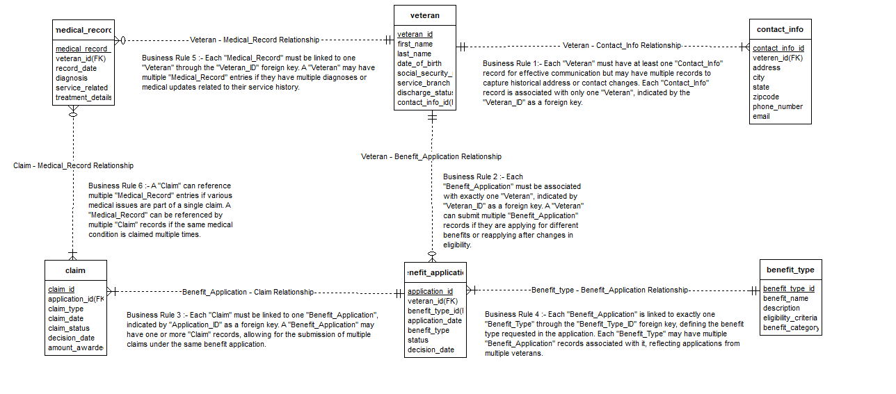
Erd diagram

Slide 8
03
TRIGGERS

Slide 9
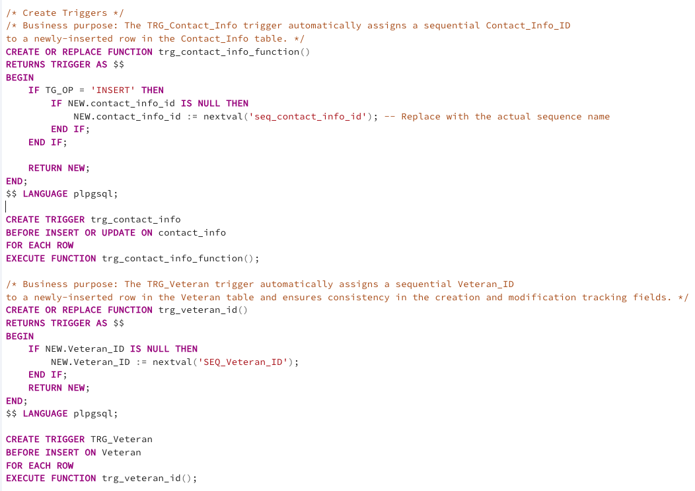
triggers

Slide 10
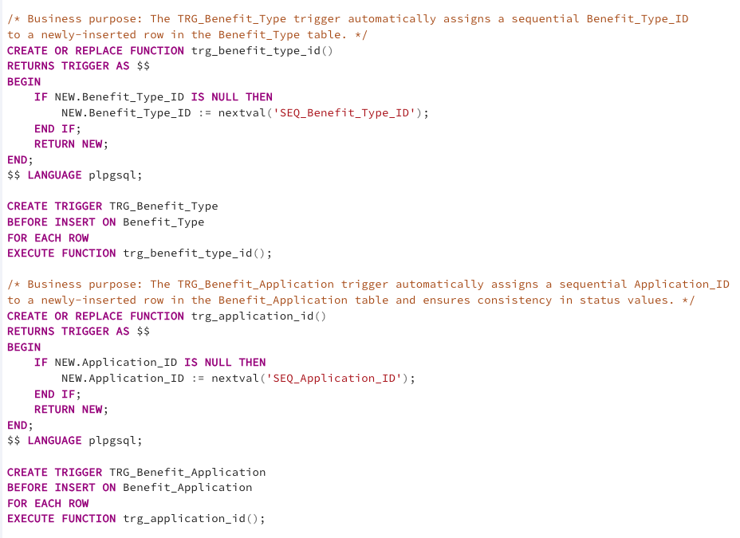
triggers

Slide 11
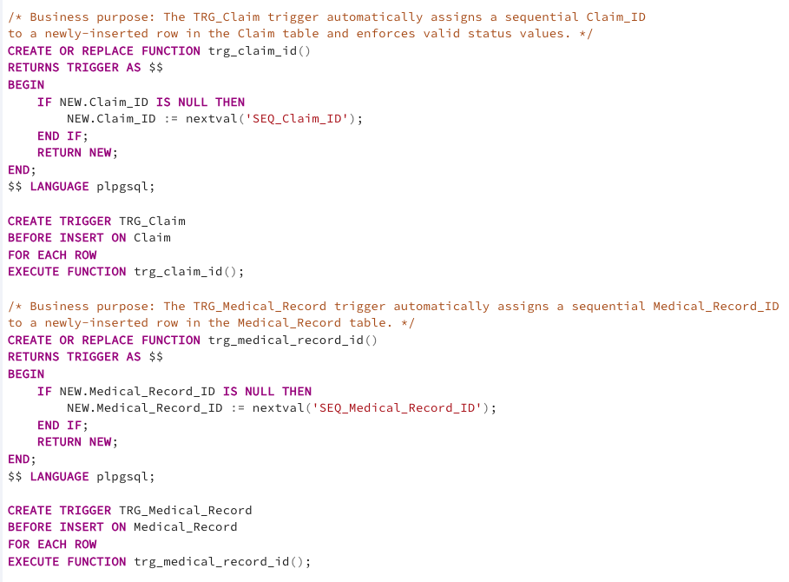
triggers

Slide 12
04
SEquences

Slide 13
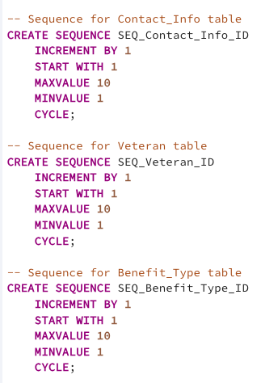
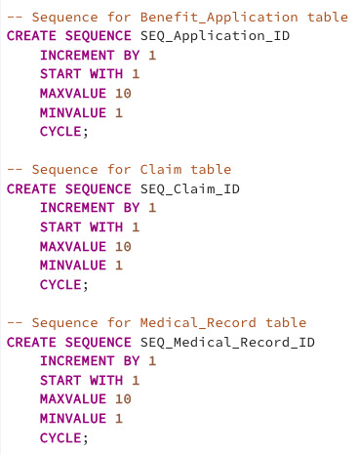
sequences

Slide 14
05
Queries and output

Slide 15
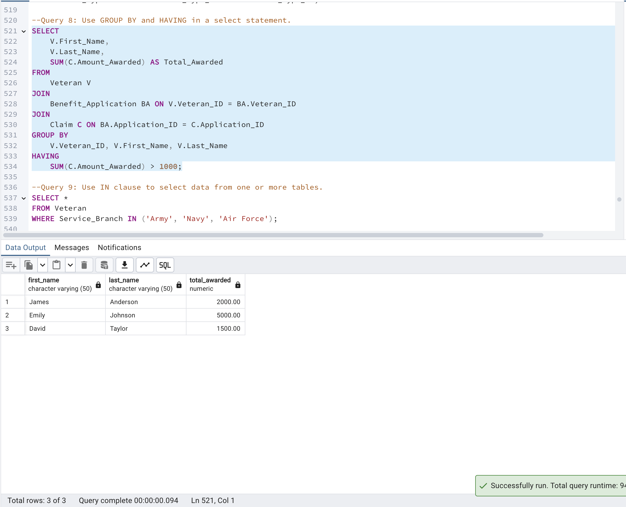
QUERIES and output
Query 8: Use GROUP BY and HAVING in a select statement.

Slide 16
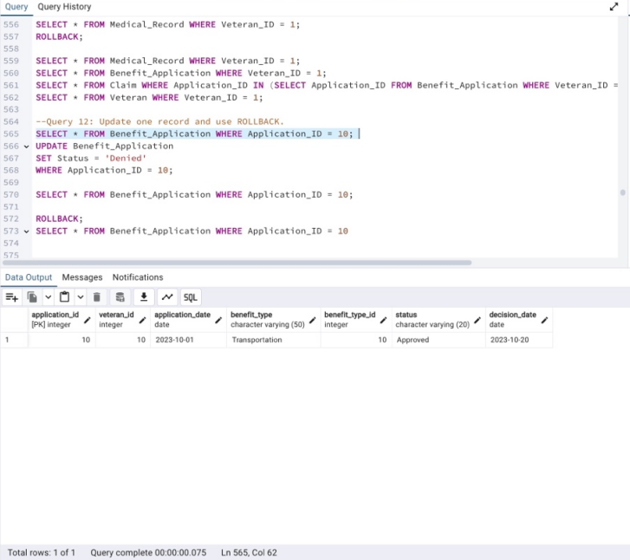
QUERIES and output
Query 12: Update one record and use ROLLBACK.

Slide 17
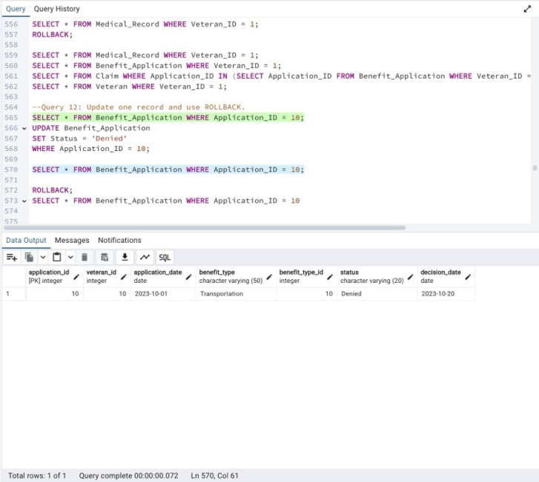
QUERIES and output
Query 12: Update one record and use ROLLBACK.

Slide 18
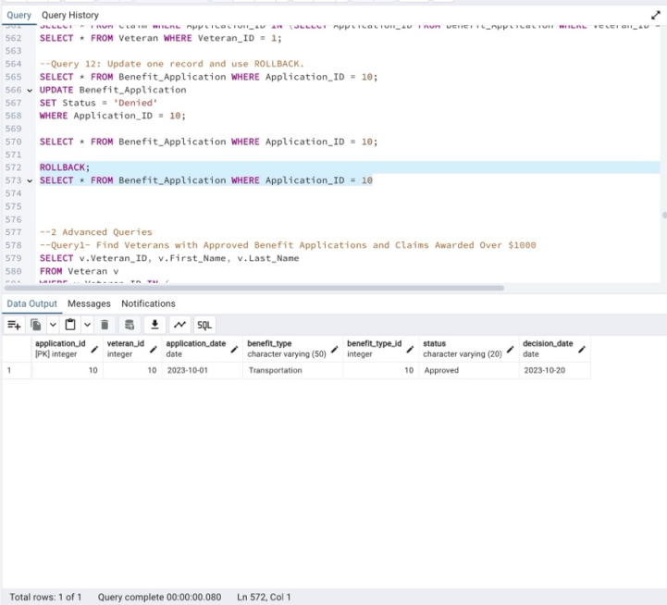
QUERIES and output
Query 12: Update one record and use ROLLBACK.

Slide 19
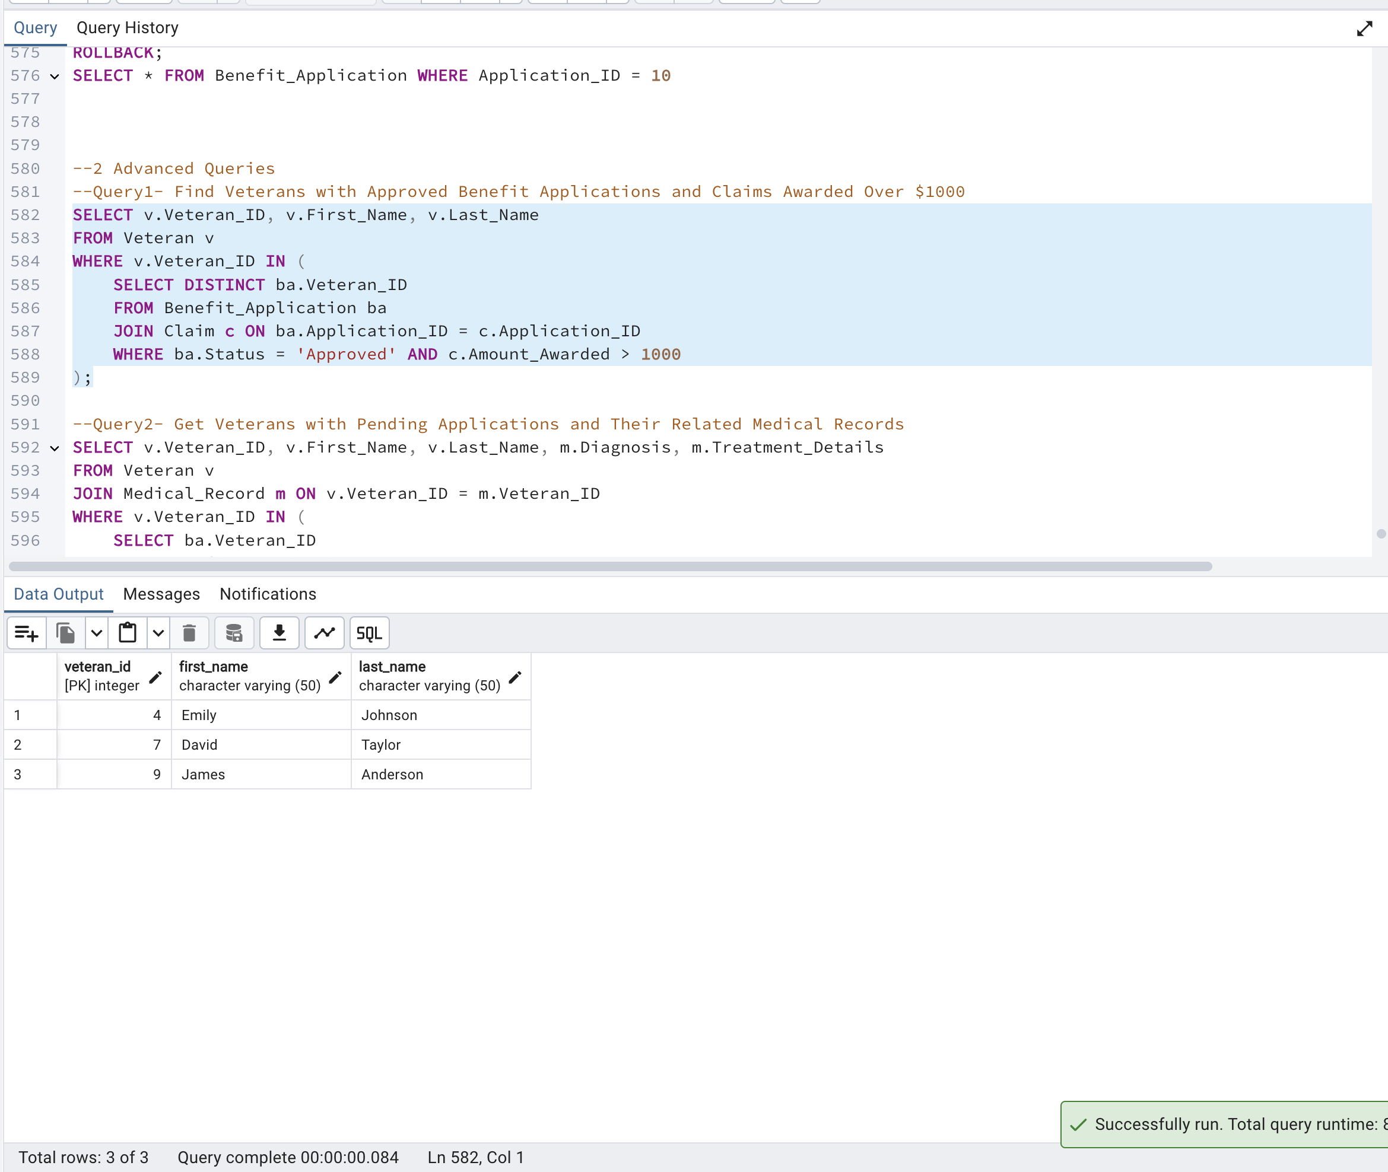
QUERIES and output
Query 13: Find Veterans with Approved Benefit Applications and Claims Awarded Over $1000.

Slide 20
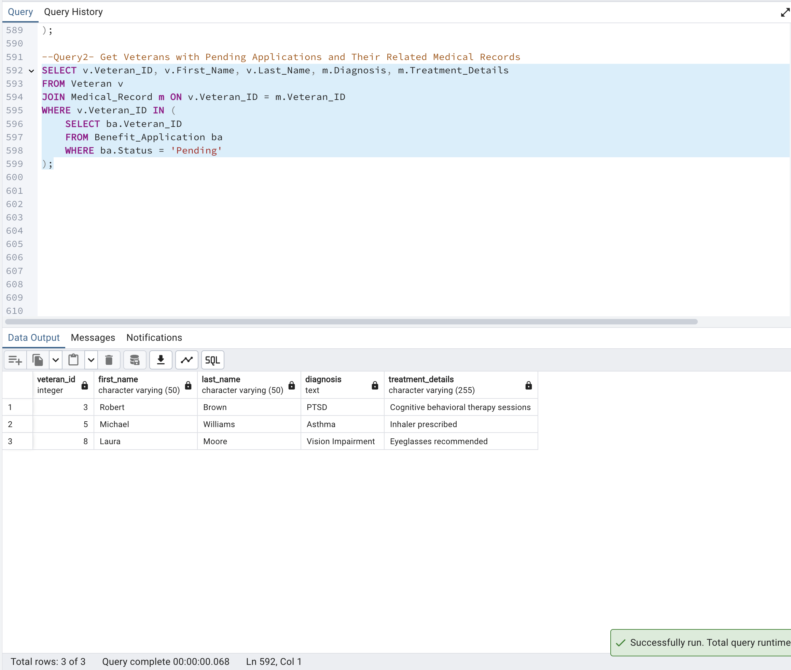
QUERIES and output
Query 14: Get Veterans with Pending Applications and Their Related Medical Records.

Slide 21
06
challenge

Slide 22

Data Integration & Accuracy: Consolidating diverse benefit categories while ensuring accurate and timely processing. Security & Compliance: Safeguarding sensitive data while adhering to strict regulatory standards. System Performance: Optimizing queries for large datasets to enhance efficiency and user accessibility.
challenge

Slide 23
Thank You for listening !
GROUP 3 : Pratik Alkutkar, Garima Singh, Wenting Lu,
Likhit Chaudhari, Rithesh Suvarapu
12/02/2024

